Slide 1
NJ SOPHE Membership Needs Assessment Survey 2019 and Strategic Planning
Suzanne Miro, MPH, MCHES
Strategic Planning Committee, Chairperson

Slide 2
Thank you to the committee!
Linda Brown
Robin Vlamis
Tiffany Neal
Carolina Focella
Kaitlin Cartoccio
Samantha Bunsa
Dominika Murphy

Slide 3
73
Total Responses
Date Created: Wednesday, April 24, 2019
Incentive: Five winners of $15 Amazon gift cards
Alyson Bilder, Athena Watkins, Sharon Skeahan, Kaitlin Cartoccio, Emelyn Falcon

Slide 4
Reminder postcards sent
Notes:
The post cards were sent to not only provide a cue to remind everyone to take the survey, but also as a reminder to set up their log in to the new NJSOPHE website if they had not yet done so.

Slide 5
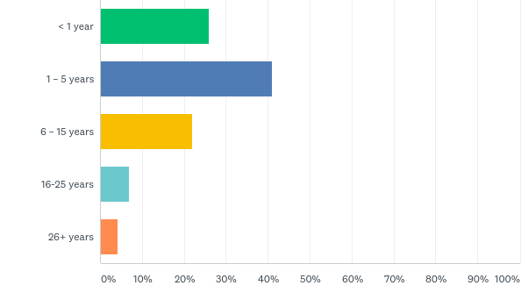
Q1: How long have you been a member of NJ SOPHE?
Answered: 73 Skipped: 0
19
30
16
5
3
Notes:
Our organization has a mix of new and seasoned members, however as you can see most are on the newer side with few respondents indicating that they have been in the organization for longer than 15 years.

Slide 6
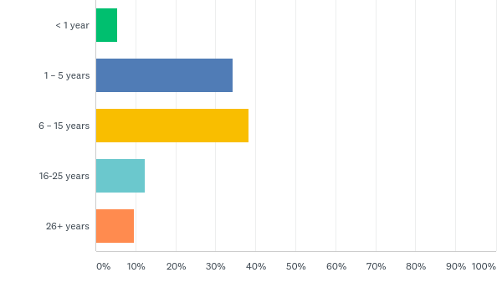
Q2: How long have you been in the health field?
Answered: 73 Skipped: 0
4
25
28
9
7
Notes:
And likewise, we see a similar pattern in the responses as to how long the respondents have been working in the health field.

Slide 7
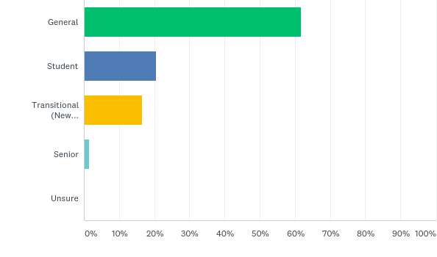
Q3: What type of membership do you have?
Answered: 73 Skipped: 0
45
15
12
1
Notes:
A majority of respondents have a general membership with fewer indicating a student or transitional or new professional membership.

Slide 8
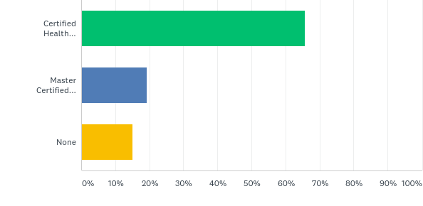
Q5: What is the highest level of health education certification that you currently have?
Answered: 73 Skipped: 0
48
14
11
Notes:
Most of our respondents are either certified or master certified health education specialists which is important to know for strategic planning purposes.

Slide 9
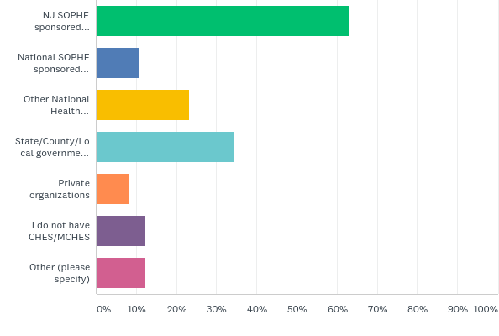
Q6: How do you obtain most of your CHES/MCHES credits? (Please choose up to 2 responses)
Answered: 73 Skipped: 0
Other Responses
46
Item | # of Responses
Other Orgs (NJEHA, webinars) | 4
Not CHES/MCHES or other certification | 2
Michigan PH | 1
SOPHE CORE | 1
Newly certified | 1
Category II credits | 1
NJ SOPHE | 1
8
17
25
6
9
9
Notes:
NJSOPHE is the only public health organization in New Jersey dedicated solely to supporting health educators and is an important source of providing continuing education credits for CHES and MCHES. As we can see here, our members obtain most of their credits through NJSOPHE programs.

Slide 10
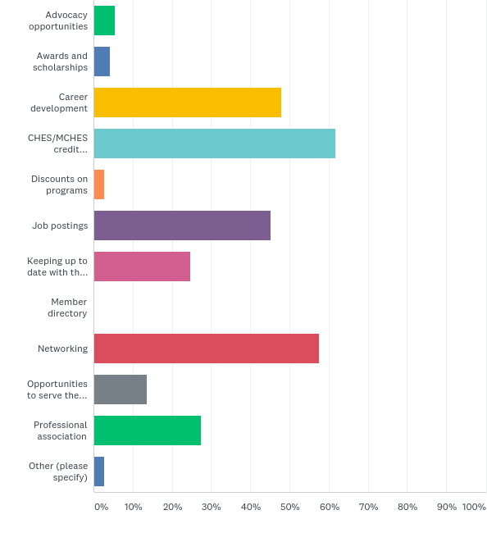
Q7: What were your main reasons for joining NJ SOPHE? (select up to 3 answers)
Answered: 73 Skipped: 0
4
0
3
42
35
10
45
20
2
2
33
18
Other Responses
Encouraged at school/by professor (2)

Slide 11
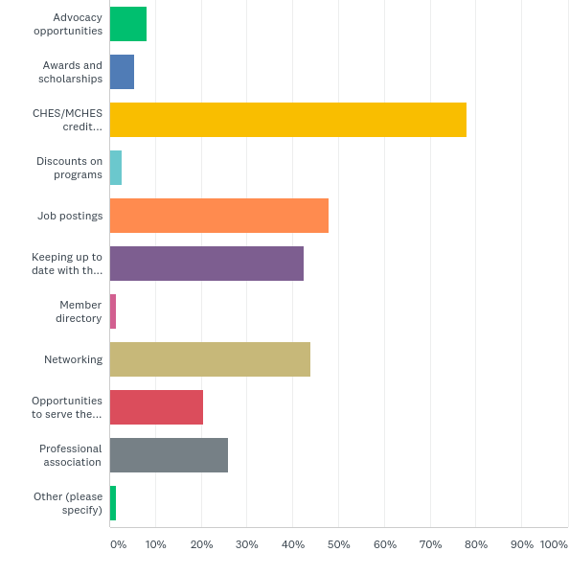
Q8: What NJ SOPHE member benefits have you found to be the most valuable? (select up to 3 answers)
Answered: 73 Skipped: 0
1
6
4
32
Opportunity to serve the profession
15
57
19
2
35
1
Keeping up to date with the profession
31
Other Response (1)
Interesting Programs

Slide 12
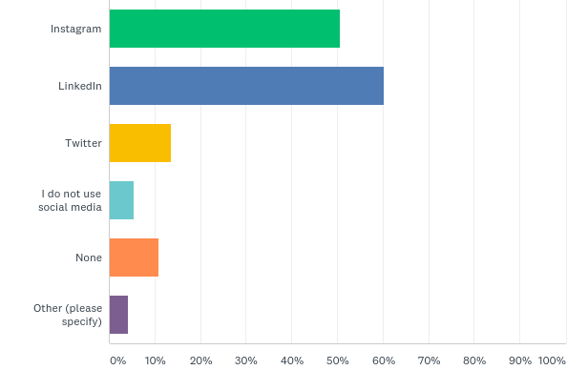
Q14: NJ SOPHE currently maintains an active Facebook page. Which of the following other social media platforms would you like to see NJ SOPHE start using? (Please check all that apply)
Answered: 73 Skipped: 0
37
44
10
4
8
Other Response (3)
Not an active user/don’t have time to use (2)
Unsure (1)
3

Slide 13
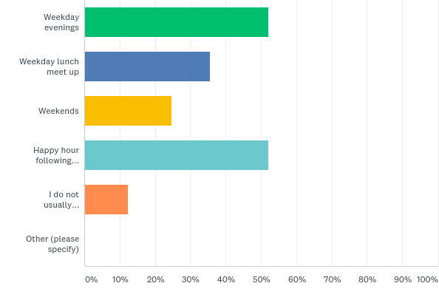
Q16: Please indicate your time preference for NJ SOPHE social/networking events: (Select all that apply)
Answered: 73 Skipped: 0
38
26
18
Happy Hour Following Annual Meeting
38
I do not usually participate in networking events
9

Slide 14
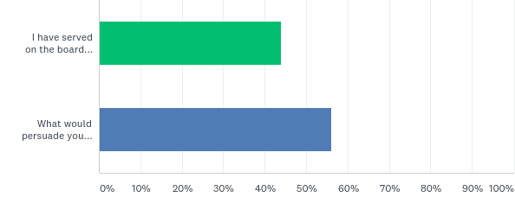
Q18: NJ SOPHE relies on volunteers to serve on its board and committees. If you haven’t been involved what could persuade you to participate?
Answered: 73 Skipped: 0
Item | # of Responses
Lack of knowledge of openings/provide clear expectations of role and time commitment | 10
Lack of time | 7
Nothing/Don’t know | 5
Interested (Would if asked/New members/More experience/looking for job) | 5
Ability to serve virtually/in local area | 4
Incentives (recognition, educational opportunities, CHES credits) | 4
Job opportunities | 2
One answer each: Leadership responsibilities One time effort Participate in research study | 1 answer each
I have served on a Board or Committee
32
What would persuade you to get involved?
41

Slide 15
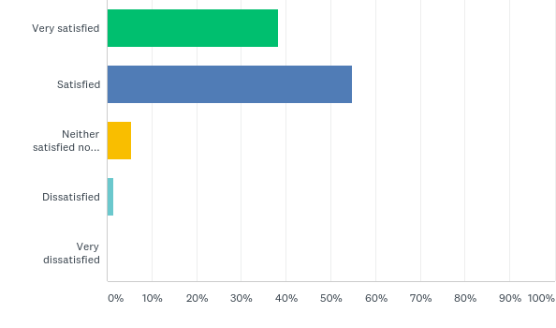
Q19: How satisfied are you with NJ SOPHE?
Answered: 73 Skipped: 0
28
40
4
1

Slide 16
Q 20: What could NJ SOPHE do to better serve your needs?
N=57
Item | # of Responses
N/A, None, Satisfied | 22
Programming: More webinars/programs More trainings in my area (all singular regions mentioned separately) MCHES/Advance professional competencies Announce program dates as early as possible Networking at programs to build relationships & social capitol/activities to facilitate Continue with engaging speakers Better access to programs for those without transportation | 5 3 2 1 2 1 1
Networking More events Mentor/buddy program Advice – switching to health ed career/student loan debt repayment | 3 1 2
Jobs/Resources Post more jobs (specific regions mentioned) Job fair Nutrition/Dietetic jobs Public health volunteer opportunities | 4 1 1 1

Slide 17
Q 20: What could NJ SOPHE do to better serve your needs?
CONTINUED
Item | # of Responses
Advocacy Updates on advocacy issues at Federal & NJ level | 2
Communication Email more educational content/without logging in Share resources/programs/curricula Post updates on social media Create Instagram account (with offer to run) | 3 1 1 1
Organization Make better connections with academic partners to reach students Get more people involved in committees | 1 1
Other I need to make more of an effort to get more from membership Study partner for CHES exam | 1 1

Slide 18
Strategic Planning
We hear you! - Review membership survey – incorporate into new plan
Board retreat exercise and review of the past strategic plan
Meetings and conference calls with strategic planning committee

Slide 19
Strategic Plan
Priority Areas
Professional Development
Communication and Outreach
Advocacy
Operations and Future Growth
Membership
Notes:
Priority areas
Objectives
Tasks
Measures
Responsible parties

