Slide 1
Share your photos from today!
#NJSOPHE35

Slide 2
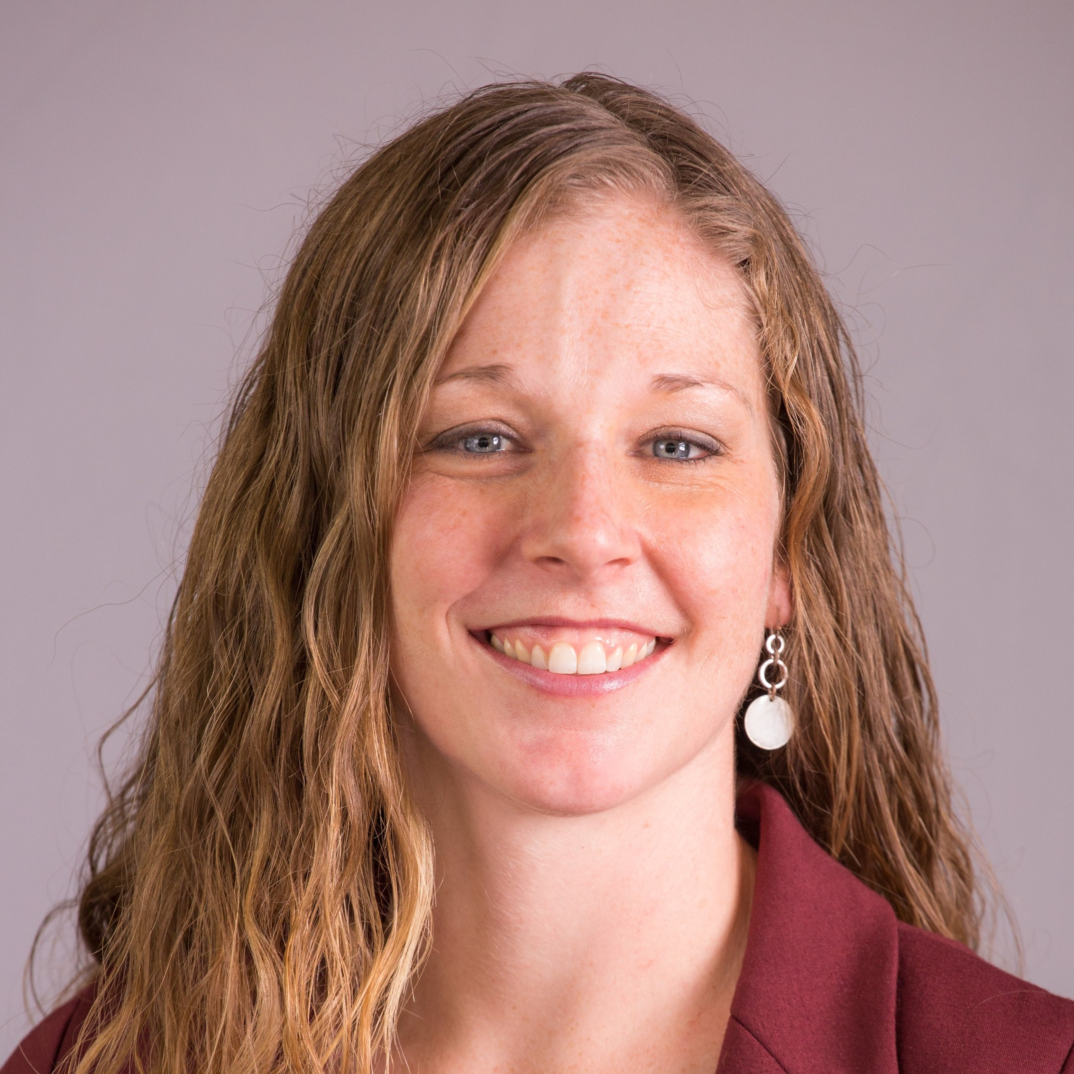
President: Linda Brown
Helped plan 35th Anniversary Celebration – Today at 3:30 PM!
Grant Partnership for Climate Change Convening at Rutgers Bloustein School on June 24
NJ Master Energy Plan Review
Health Notes training: rapid, objective summary of proposed legislation using principles of health impact assessments
COPE (Cost of Poverty Experience) – looking at ways to offer more NJ workshops
Strategic Planning:
Recorded overview presentation of member survey results
Using data from member survey to improve NJ SOPHE
Submitted letter of support to host National SOPHE meeting in New Jersey in 2022
Chapter re-designation process and Annual Report
Supporting committees: Strategic Planning, Program, Advocacy, Networking, Students & New Professionals
Meetings
Met with Deputy Commissioner of Health
NJDEP Climate Resilience Social Vulnerability Project Working Group
PHACE
Past Presidents Retreat
SOPHE House of Delegates
Facilitated monthly board meetings and planned annual retreat
Contact info: linda.paquette@gmail.com 732-718-7141

Slide 3
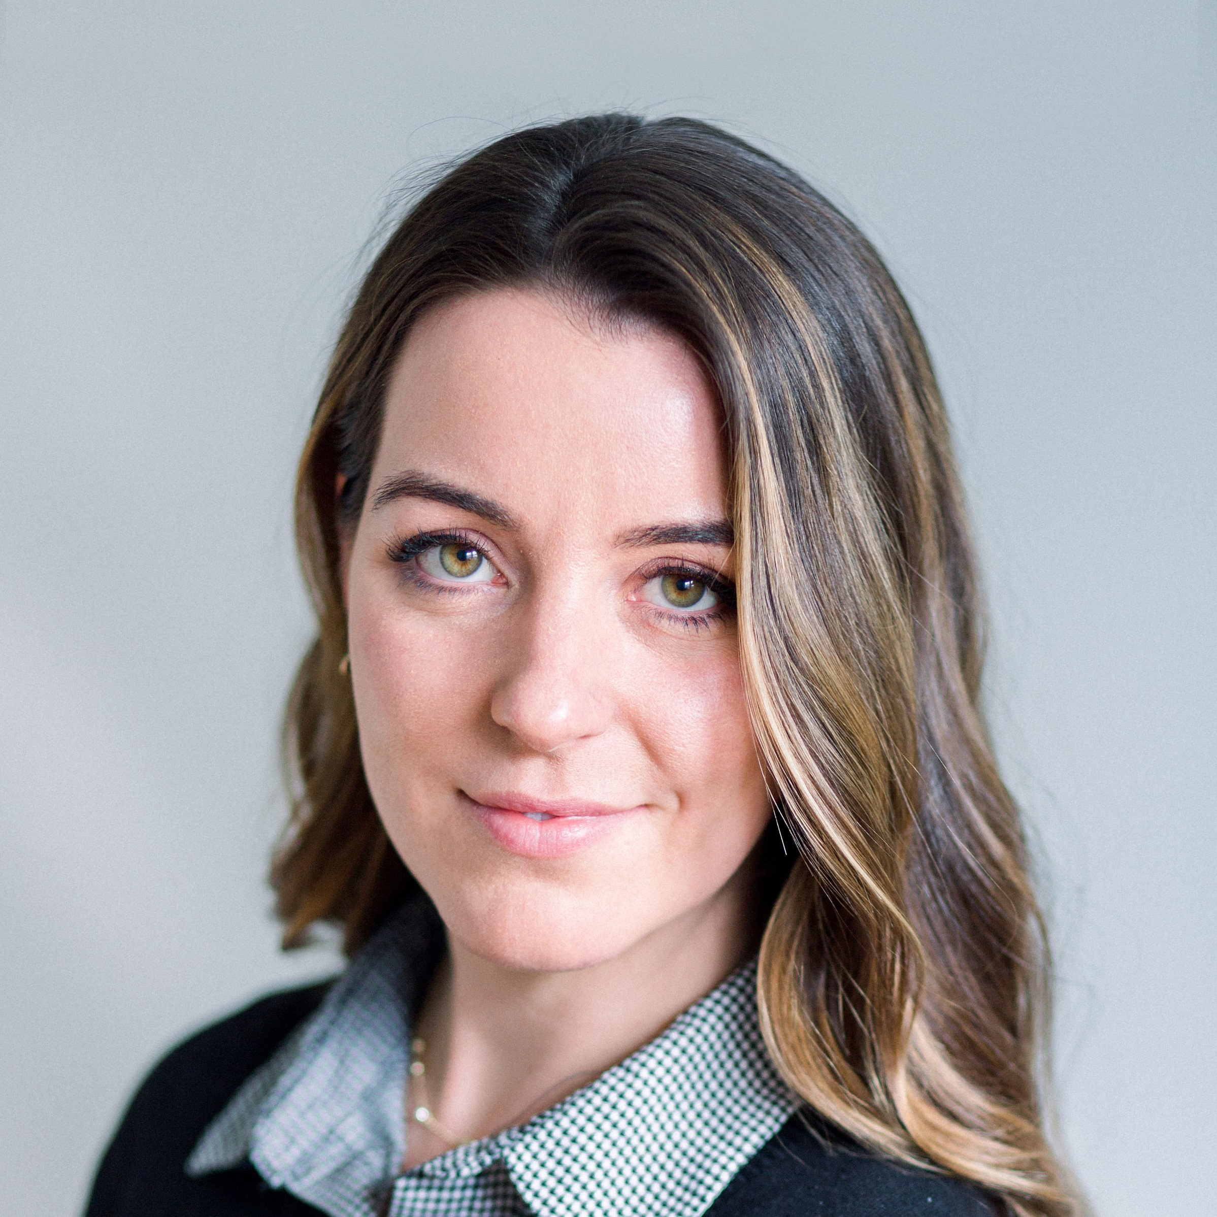
President-Elect: Samantha Bunsa
2020 Planning: Budget priorities
Grant Partnership for Climate Change Convening at Rutgers Bloustein School on June 24
Past President Retreat – October 4th
Reviewed membership survey results
Gained input for strategic planning priorities of membership retention and recruitment
Serving as an NJ SOPHE representative at PHACE meetings
Reviewed Policies and Procedures Manual
Participation and support to Program committee, Membership survey development, and Strategic Planning
Contact info: samantha.bunsa@gmail.com

Slide 4
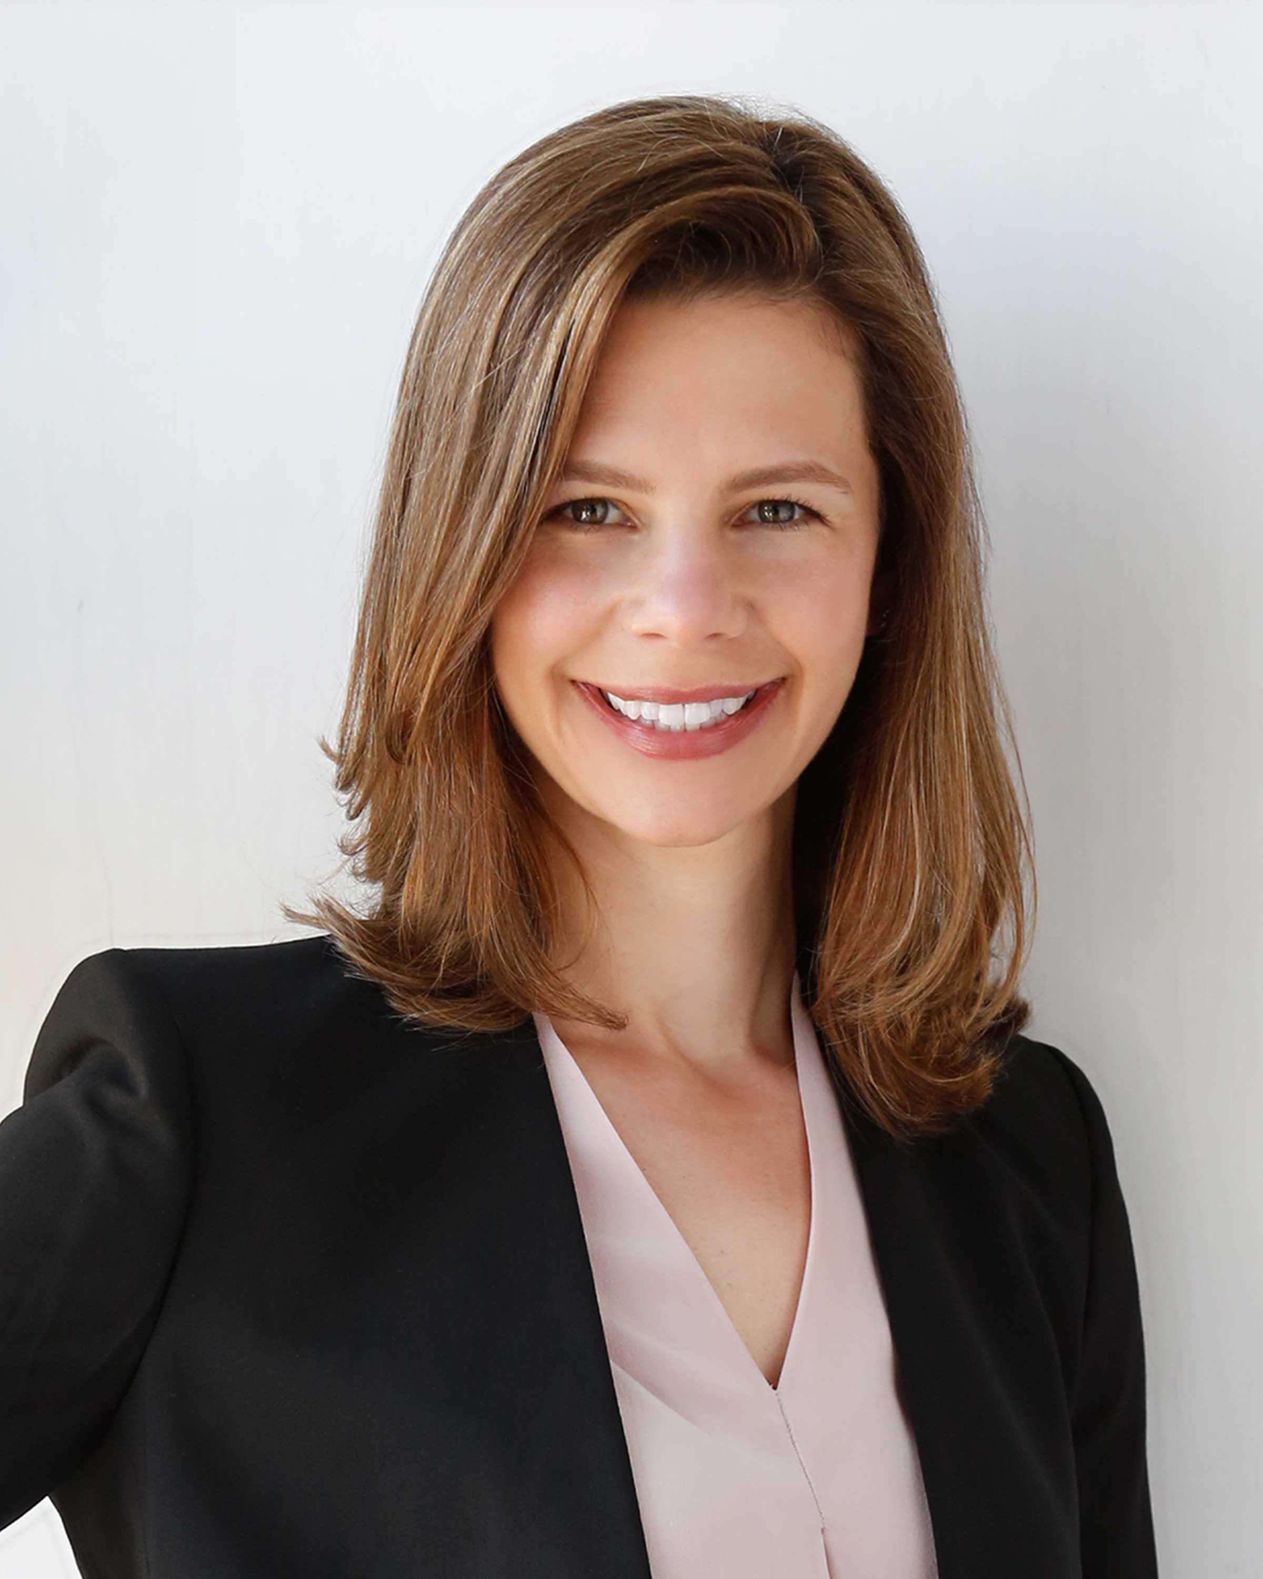
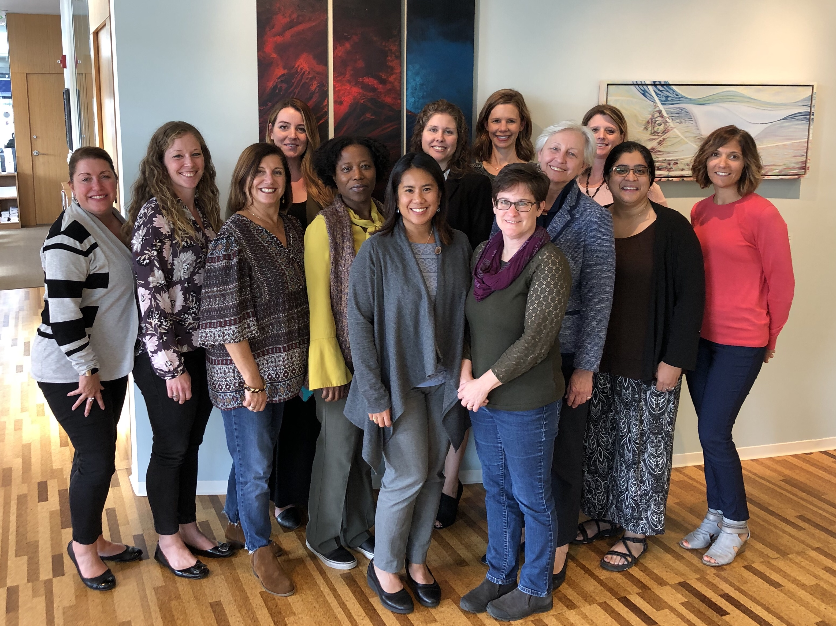
Past President: Robin Vlamis
Executive: Attended all Board meetings and assisted with all core functions, especially operation of new website
Advocacy: Participated in National Public Health Week event in Trenton with PHACE; Assisted with position briefs
Grants: Served on committee to plan and facilitate Rutgers’ convening: “Building Capacity to Address Impacts of Climate Change on Health Inequities in New Jersey” on June 24th
Professional Development: Presented webinar on June 20th and August 8th (for DOH series) Can Data Make a Dent in Addressing Social Determinants of Health? featuring the debut of our Community Health Data Alignment (CoHDA) Model
Program: Assisted with planning efforts for 35th anniversary celebration
Strategic Planning: Participated in development of new strategic plan
2020 Elections process: Formed a Nominations committee to recruit candidates for 4 positions and held election
Academic Advisory Group: Held phone meetings in March and September (comprised of representatives from colleges and universities in NJ who have health education programs)
Policy & Procedure Manual: Working on new document to encompass roles and responsibilities of board members as well as operational policies and procedures of the organization
Past Presidents Advisory Group: Held retreat of Past Presidents in October at Dodge Foundation in Morristown
Contact info: robinvlamis@gmail.com (973) 452-1042

Slide 5
Treasurer: Judith Francis
Continue to work with Executive Board to manage chapter cost and expenses.
Continued use of Wild Apricot (Affinipay) to manage chapter’s electronic payments.
Collaborated with Technology committee to design a form to keep track of expenses.
Mid-year meeting bank balance as of 6/5/19 - $11,922.33
Annual meeting bank balance as of 12/5/19 - $19,601.69
Contact info: francisj4@wpunj.edu

Slide 6
Treasurer: Judith Francis
Budget Category | Description | Budget | Balance
Executive Committee | Chapter and state fees, board retreat | $1,030.00 | $230.00
President | National SOPHE dues, advisory committee | $745.00 | $0.00
President Elect | National SOPHE dues | $195.00 | $0.00
Advocacy | Advocacy summit | $900.00 | $76.57
Treasurer | Accountant, postage, P.O. Box | $520.00 | $108.00
Program | Midyear and annual | $6,550.00 | $450.00
Students and New Professionals | Networking Events | $ 500.00 | $237.70

Slide 7
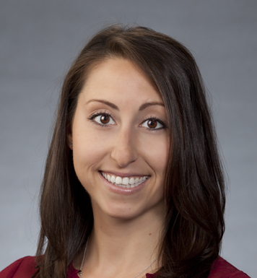
Secretary: Hillary Saputski
New Board Member monthly reporting template project
Committee Support
Program Planning Committee
Support with topics and presenters for the mid-year and annual meetings
Panelist presenter for the mid-year meeting (Topic: Technology & Workplace Wellness Programs)
Session moderator at the annual program
35th Anniversary Celebration Committee
Contact info: hillary.saputski@gmail.com (724) 316-0132

Slide 8
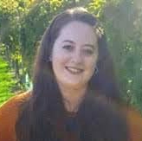
Chapter Delegate: Kaitlin Cartoccio
Began attending SOPHE Board of Trustees Meetings monthly as Delegate Trustee
What’s a Delegate Trustee?
Acts as a liaison to the Board of Trustees for New Jersey, New York, Pennsylvania, Ohio, Great Lakes, Indiana, Iowa, and Minnesota.
Oversaw Re-designation for all Chapters due 10/31
Participated in SOPHE House of Delegates meetings
Participated in National SOPHE Committee
National Conference Planning Committee – Continuing Education Committee
Participated in NJ SOPHE meetings
Committee Support
Program
35th Anniversary
Networking
Strategic Planning
Fundraising
Social Media
REMINDER
70th SOPHE Annual Meeting in Atlanta, Georgia March 18 – 20th. “Linking Science and Social Justice: Health Education as a Catalyst for Change”
Early Bird Registration ends December 15th
If you are a Chapter Member but NOT a National Member, see me for a special discount code for the 2020 Meeting!
Contact info: kcartoccio@bernards.org

Slide 9
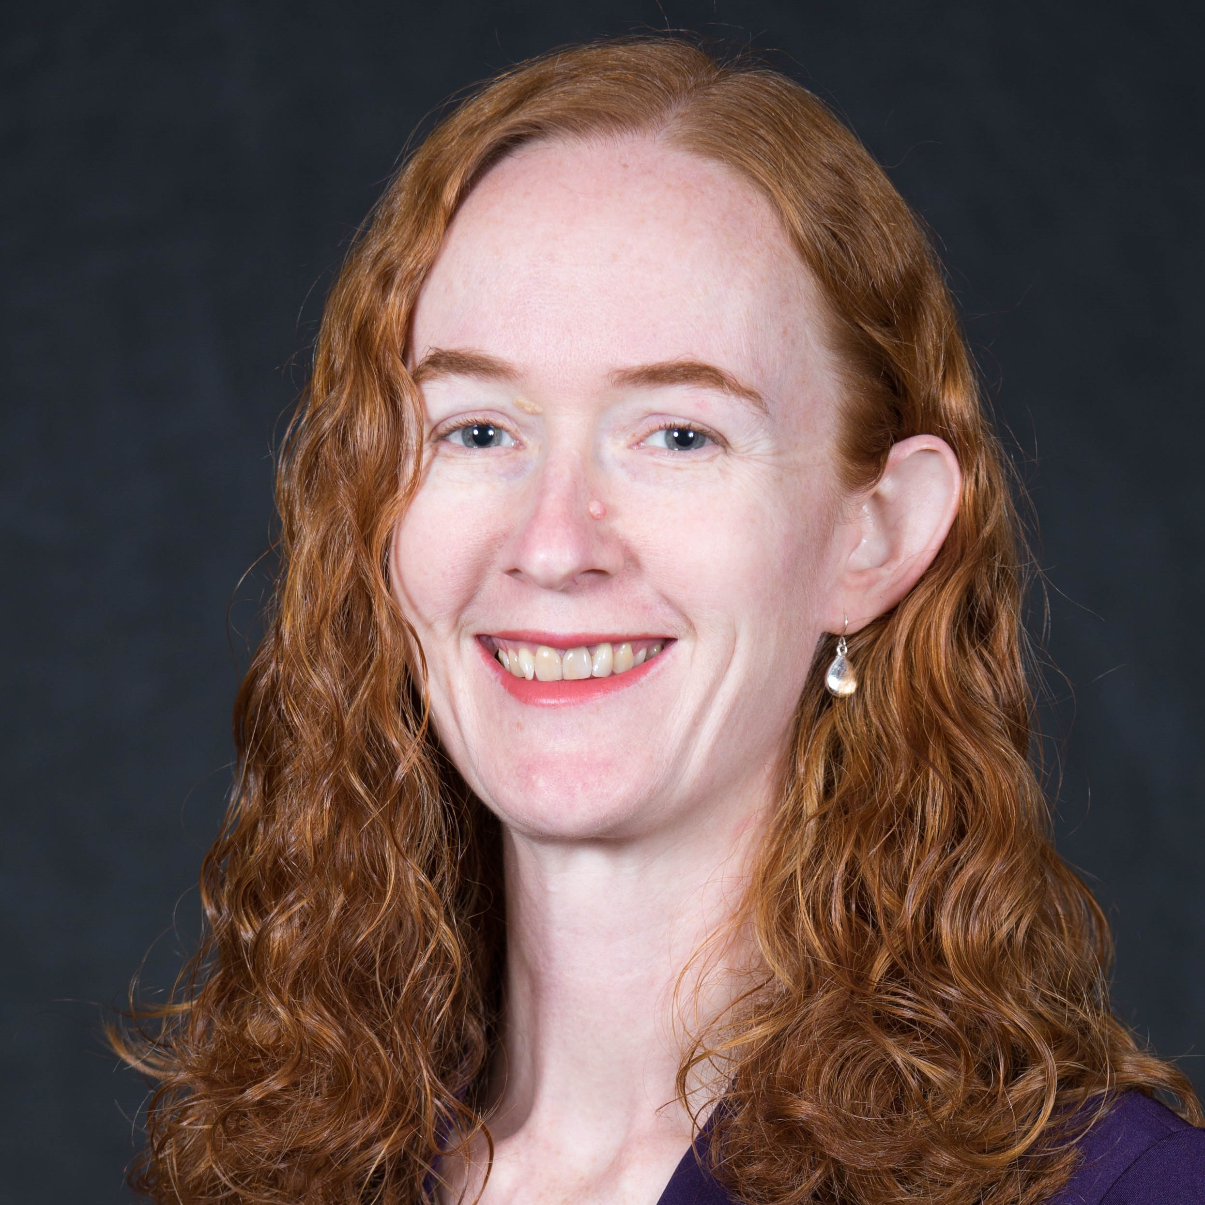
Communications Coordinator
Helped to develop questions for member survey
Developed postcards and coordinated mailing to remind members about survey
Created 35th Anniversary logo
Posted at least twice a week on Facebook
Updated and maintained website
In the past month, the website had 898 users making 1,492 visits, with an average of 3.57 pages viewed per visit.
66% got to our site directly (by typing in our URL), 27% by search, 7% by referral
Helping on strategic planning and 35th anniversary celebration sub-committees
OPT IN! Subscribe to forums to get job postings and more!
njsophe.org/Forum-instructions/
Contact info: tiffany.lewis@gmail.com (415) 694-8032

Slide 10
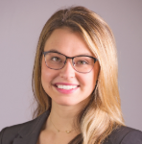
Student & New Professionals Coordinator: Sheyenne Buchalski
Resource Library
Employer Outreach Flashcard
Employer Outreach Infographic/Brochure
Health Education Professional Organizations & You Flashcard
University/College Connection Flyer
Professional Association Bank Flyer
Student/New Professional/Transition Member Targeting
Scholarships, awards, poster sessions, coordination of study groups and resources
Participated in NJ SOPHE meetings
Committee Support
Program (Mid-Year & Annual)
35th Anniversary
Networking
Social Media
REMINDER
5 new video modules posted to NJDOH website on disease investigation in NJ + Resource Guide Access: https://www.nj.gov/health/cd/edu_training/
Contact info: Sheyenne.Buchalski@gmail.com

Slide 11
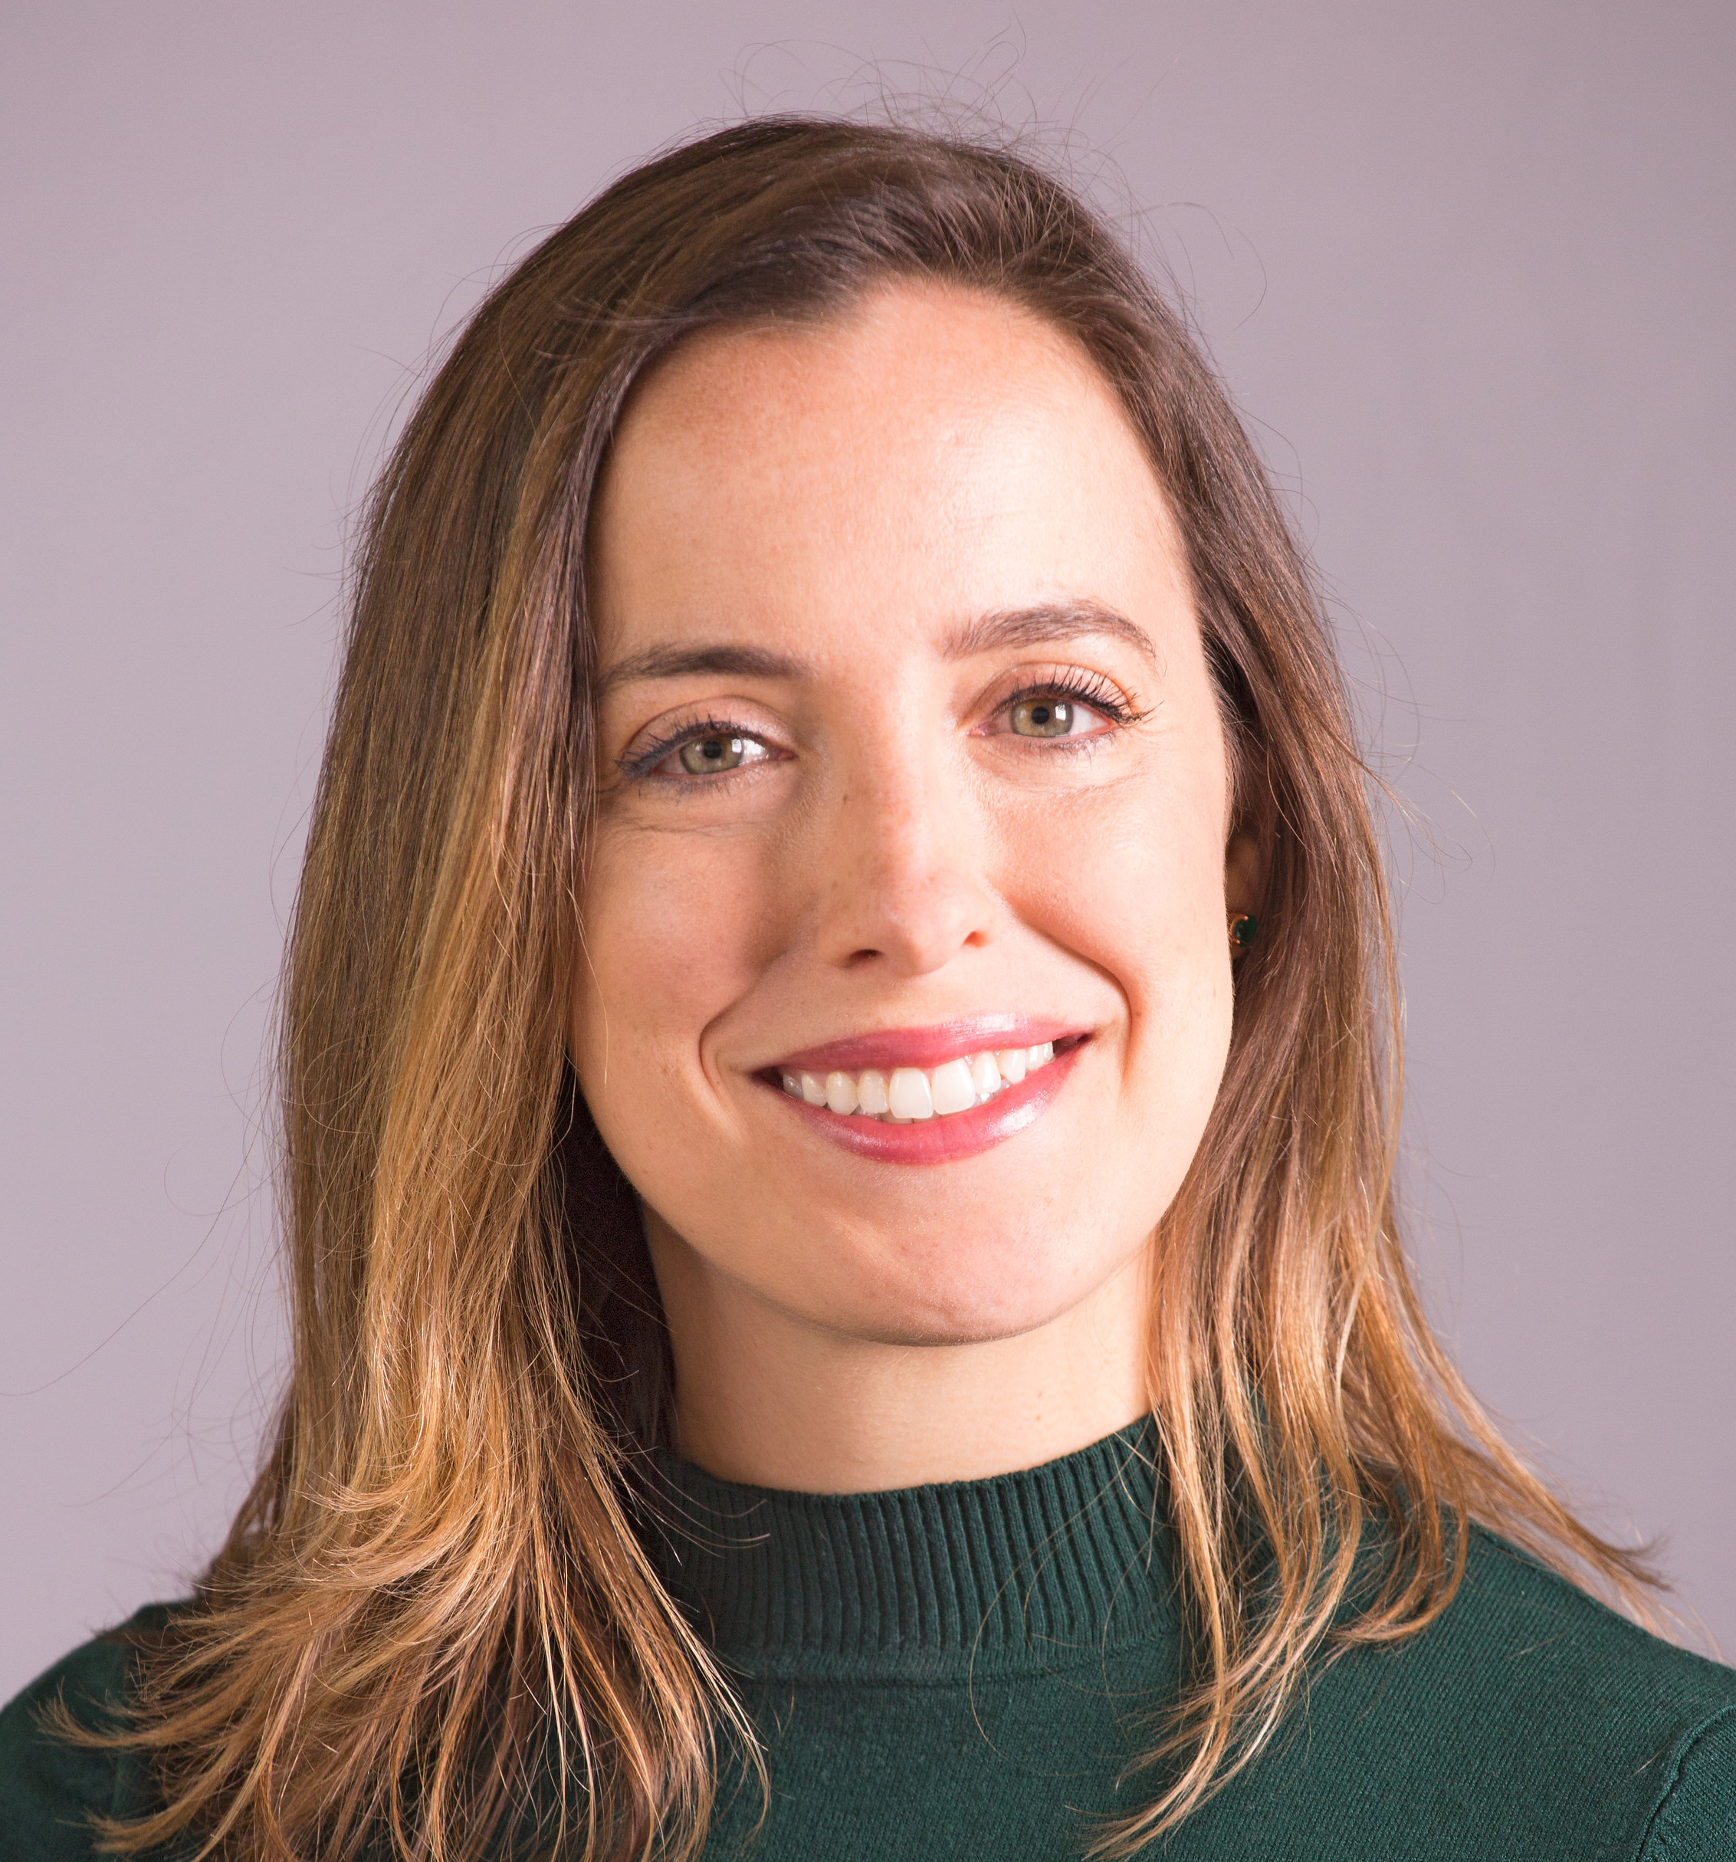
Advocacy: Tara Rice
Position briefs
Published Vaccines position brief
Published E-cigarettes position brief
In the process of developing Climate Change position brief
Legislative Events:
Working towards planning events for April 2020 for National Public Health Week event in Trenton with PHACE
PHACE
Serving as an NJ SOPHE participant on PHACE committee meetings
Contact info: tara.michele.rice@gmail.com (484) 358-6730

Slide 12
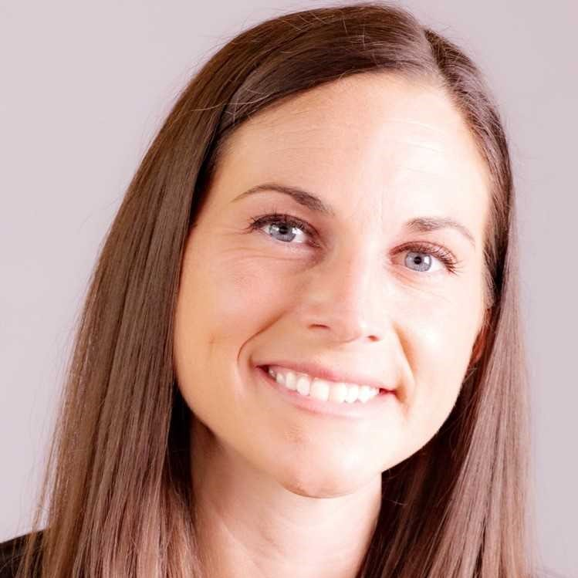
Awards and Scholarships: Krista Reale
Accomplishments
Transitioned role of committee chair
Promoted 2019 awards and scholarships applications
Reviewed submitted applications and selected winners
Doubled the number of hardship scholarships available (2 to 4)
Committee Members: Erin Brady, Jessica Kelly, MaryAnne Kokidis, Jennifer Smith
Future Initiatives
Identify different ways to promote awards and scholarships to members and non-members (videos, social media)
Develop better ways to streamline the application process (electronic submission, recommendation forms)
Interested in Awards & Scholarships?!
Please contact Krista Reale at njsopheawards@gmail.com for more information on the committee and how to join!
Contact info: njsopheawards@gmail.com

Slide 13
Job Bank: Kiameesha Evans
Send an email to Kiameesha (babydoc96@aol.com) to learn more about NJ SOPHE’S COOLEST COMMITTEE!!!

Slide 14
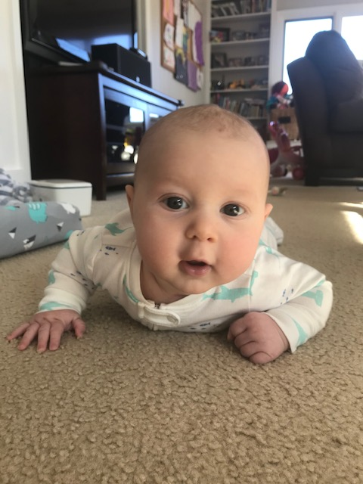
Membership: Dominika Murphy
Accomplishments:
Timely ongoing membership maintenance and outreach
Immersed myself in new role and the Wild Apricot System
Participated in Strategic Planning committee
Participated in the membership hardship scholarship expansion planning
Membership acquisition and engagement planning
Continued tweaks of Wild Apricot membership items to better reflect membership needs
Grew a human!!
Future:
Execution of membership plan activities
Develop improved process for handling PO’s in Wild Apricot
Continued planning for membership acquisition activities and engagement
Grow and cultivate membership committee
Contact info: dominikamurphy@gmail.com

Slide 15
Membership: Dominika Murphy
Welcome new and returning members!
NJ SOPHE’s membership has been increasing annually – and has grown 13% since the same time last year!
Level | Total (2019) | Total (2018)
General (1 Year) | 54 | 45
General (2 Year) | 40 | 37
Senior | 2 | 1
Student | 50 | 52
Transitional | 13 | 12
Total | 166 | 147
Notes:
Total Members (as of 11/30/2018) = 147
General Membership (1 year)= 45 members
General Membership (2 year)= 37 members
New professionals/transitional= 12 members
Student= 52 members
Senior= 1 member

Slide 16
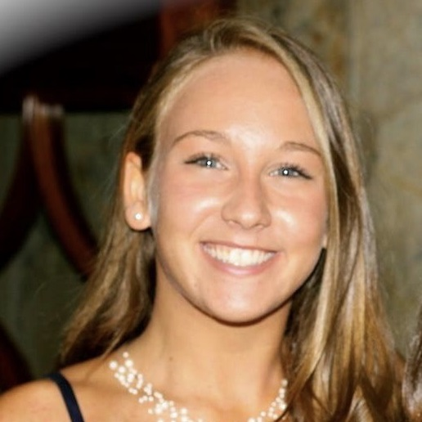
Networking: Carolina Focella
Accomplishments:
NJ SOPHE Happy Hour hosted at McLoone’s Boathouse in West Orange and Long Branch
Networking event at Rutgers School of Public Health (both Piscataway and Newark locations)
Networking event at William Paterson University to both Health Education cohorts
Creation of NJ SOPHE infographic
Committee:
9 engaged committee members that help coordinate and facilitate our networking events
Always looking for new committee members! If you are interested, please email focellac@gmail.com
Future Initiatives:
Rutgers School of Public Health - Student Career & Professional Opportunities: Friday December 13th from 1-4pm
Networking at Princeton Art Museum’s ”States of Health: Visualizing Illness and Healing” Exhibit: January 2020
Plans to expand social media platforms and presence (Instagram + LinkedIn)
Contact info: focellac@gmail.com (201) 394-7153

Slide 17
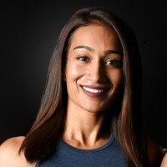
Program Co-Chair: Sonika Shankar
Planned NJ SOPHE mid-year meeting:
“Technology and Health”
Planned NJ SOPHE annual meeting:
“Climate Change”
Participated in SOPHE board meetings
Participated in NJ SOPHE meetings
Committee Support
Program
35th Anniversary
Networking
Strategic Planning
Students and New Professionals
REMINDER
Register to be an NJ SOPHE member (student and transitional memberships offered at a discounted price) to get full access to:
Jobs and internship listings
Students and new professional networking events
Webinars on some of your favorite public health topics
Contact info: sonika.njsophe@gmail.com

Slide 18
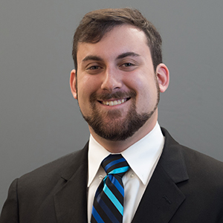
Program Co-Chair: Yonatan Gershon
Coordinated and Facilitated Webinars in 2019:
Feb 28 – A.L.I.C.E Populations: Asset Limited, Income Constrained, Employed
May 29 – Raising their VOICE: Engaging Youth in Tobacco Prevention
Jun 20 – Can Data Make a Dent in Addressing Social Determinants of Health?
Nov 22 – Expanding our Considerations of Cultural Competency
Participated in National SOPHE Continuing Education Committee
Participated in NJSOPHE meetings
Program Committee Support
Mid-year program
Annual program
If you are interested in seeing a specific health education topic covered in a webinar, or you would like to volunteer to be a speaker, please email me.
Contact info: yongershon@gmail.com

Slide 19
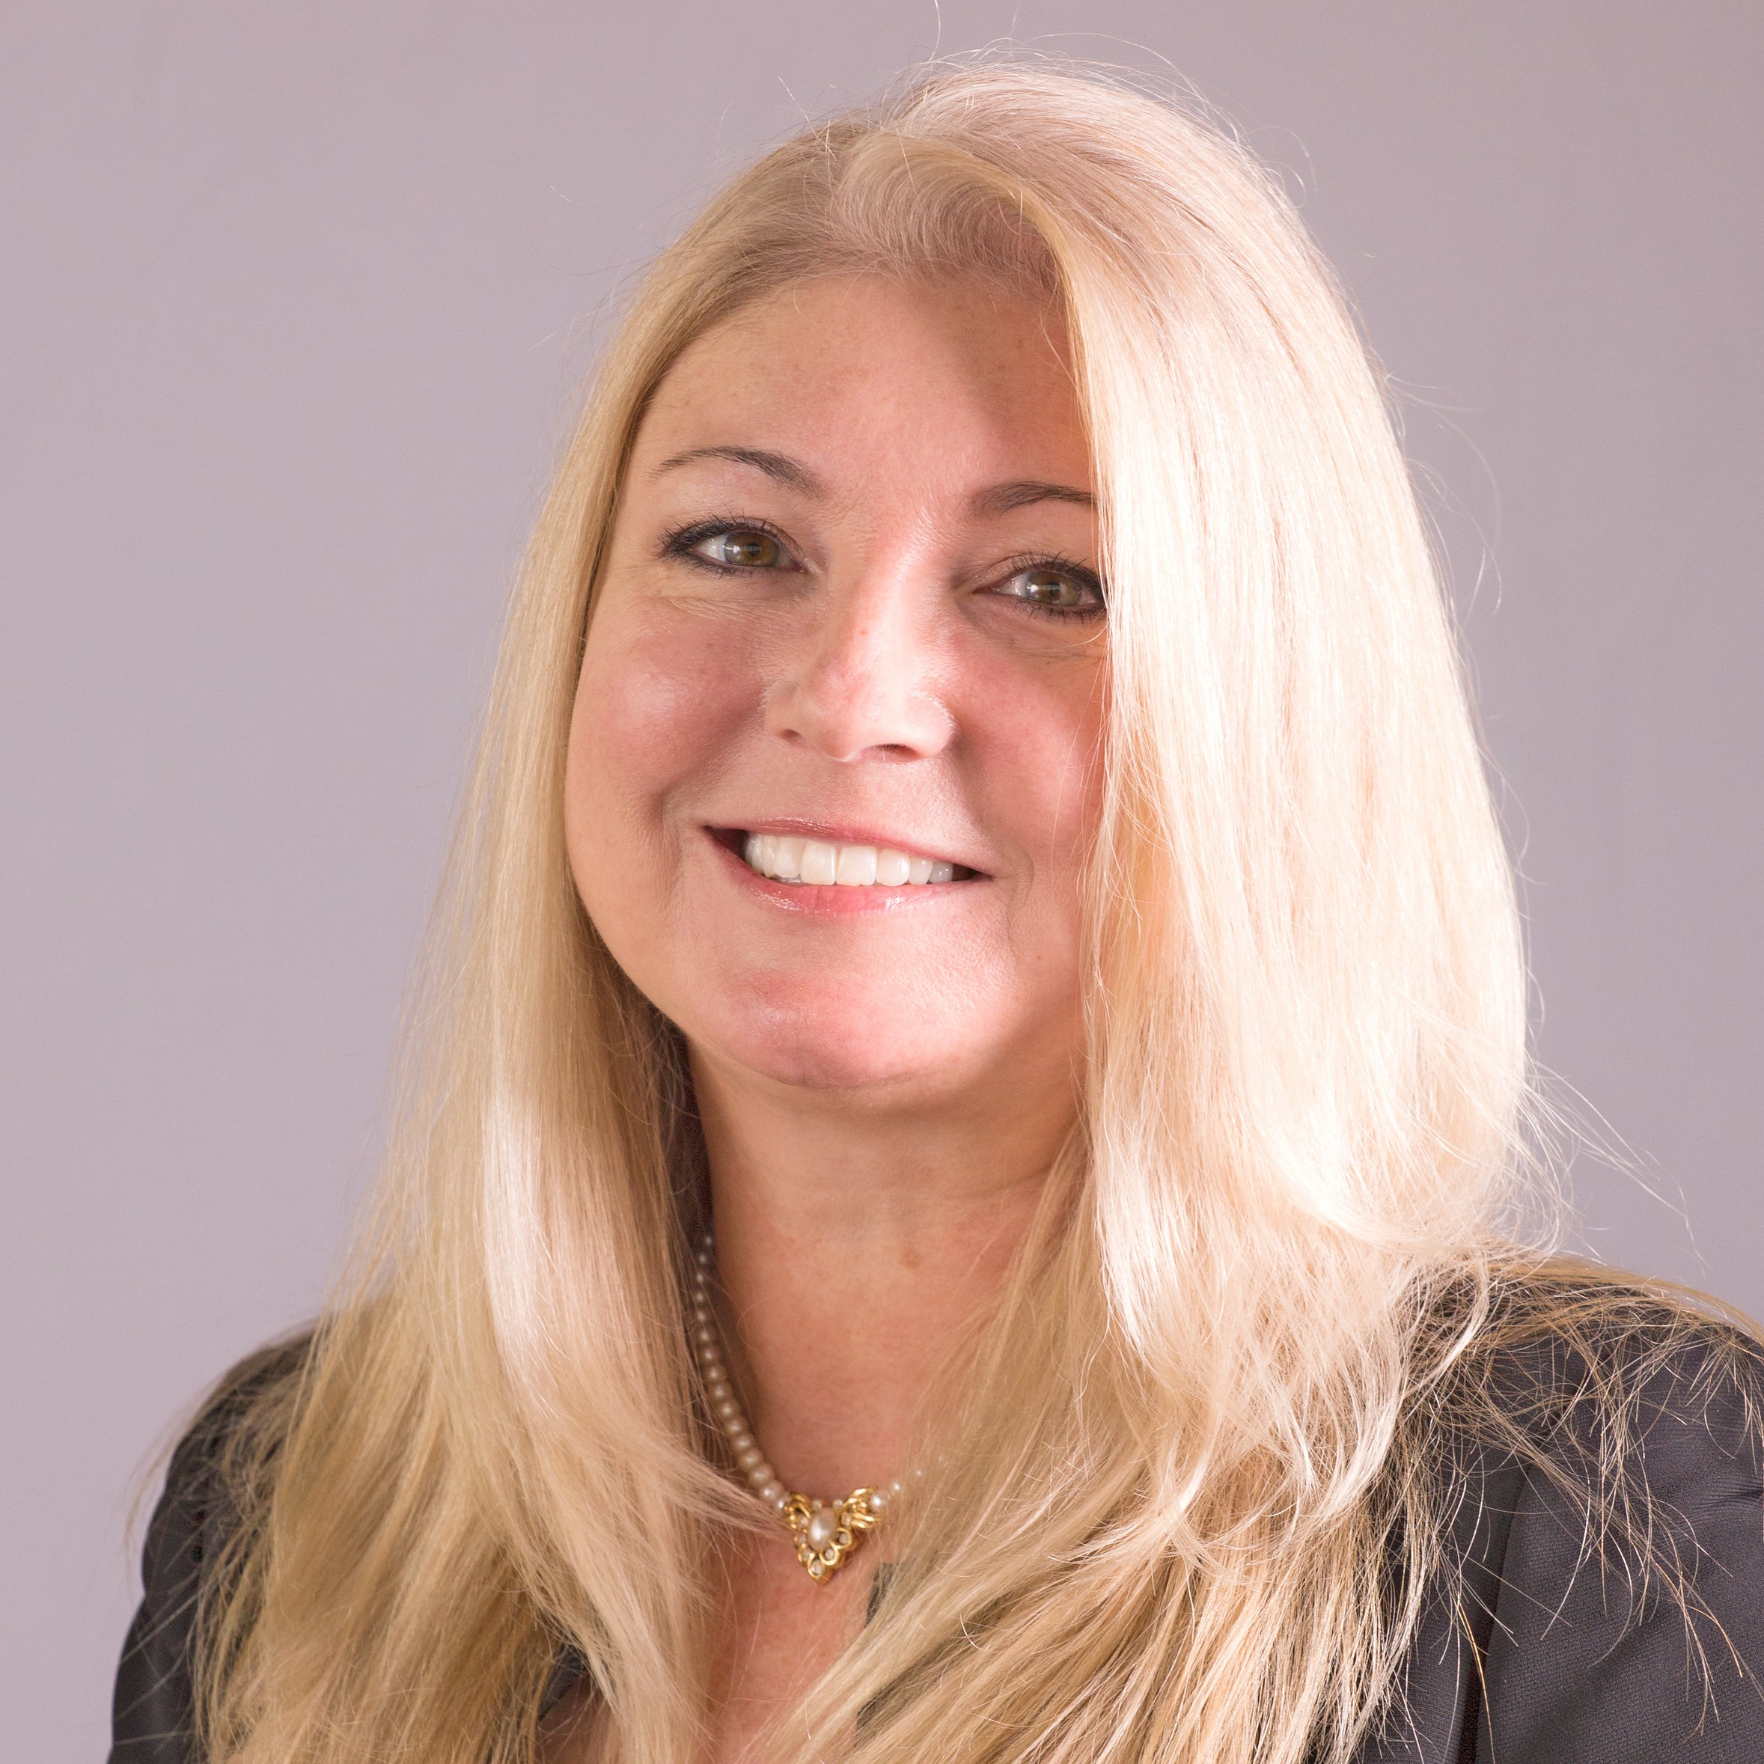
Strategic Planning: Suzanne Miro
Revising the five-year strategic plan for 2020-2024
Member survey results analyzed and incorporated
Board retreat interactive exercise to begin revising the plan
Ongoing committee meetings to develop goals, objectives, tasks, and measures
Focus areas include: professional development, communication/outreach, advocacy, operations/future growth, membership
Thank you to committee members Linda Brown, Robin Vlamis, Tiffany Neal, Samantha Bunsa, Dominika Murphy, Kaitlin Cartoccio, and Carolina Focella!!!
Contact info: Suzanne.Miro@doh.nj.gov

